Slide 1
CS 6830 · PROJECT 1
On the Hot Seat
Does winning keep an MLB manager employed?
Jacob Beal & Kameron Moss
Sean Lahman Baseball Database · 1901–2017
Notes:
Hi everyone, I'm [Jacob / Kameron], and [Kameron / Jacob] and I looked at a question every baseball fan has an opinion on: when a team is losing, does the manager really pay for it?

Slide 2
THE QUESTION
Is keeping the job really all about winning?
WE ASKED
Do managers with better records keep their jobs?
WHO THIS MATTERS TO
1
Front offices
When is it time to make a change?
Are mid-season firings really on losing teams?
2
Managers & their agents
How safe is the job, really?
Do managers who stay longer win more?
3
Fans & sports media
Is all the 'hot seat' talk backed by data?
Data: Sean Lahman Baseball Database, 1901–2017
2
Notes:
Every season you hear that some manager is "on the hot seat." Everyone assumes it's all about winning, but we wanted to see if the data actually backs that up.
This matters because a lot of people care about the answer: front offices deciding when to make a change, managers and their agents trying to figure out how safe the job is, and fans and sports media who argue about this every week.
So we asked three questions. Do managers with better records keep their jobs? Are mid-season firings really on losing teams? And do managers who stay longer win more?

Slide 3
THE DATA
2,915 manager seasons, two questions each
2,915
1901–2017
433
manager seasons
117 seasons of baseball
replaced mid-season
FOR EVERY MANAGER, EVERY SEASON, WE TRACKED
Did they finish the season?
Were they back with the same team next year?
Teams are matched by franchise, so a team that moved (Montreal Expos → Washington Nationals) is still the same job. We start in 1901 because before that, teams folded too often to tell a firing from a team disappearing.
Data: Sean Lahman Baseball Database, 1901–2017
3
Notes:
We used the Sean Lahman Baseball Database, mainly the Managers and Teams tables. That gave us 2,915 manager seasons from 1901 to 2017.
For every one, we tracked two things: did the manager finish the season, and were they back with the same team the next year? We matched teams by franchise, so when the Expos moved and became the Nationals, it still counts as the same job. And we started at 1901, because before that, teams folded so often that "not back" usually just meant the team was gone.

Slide 4
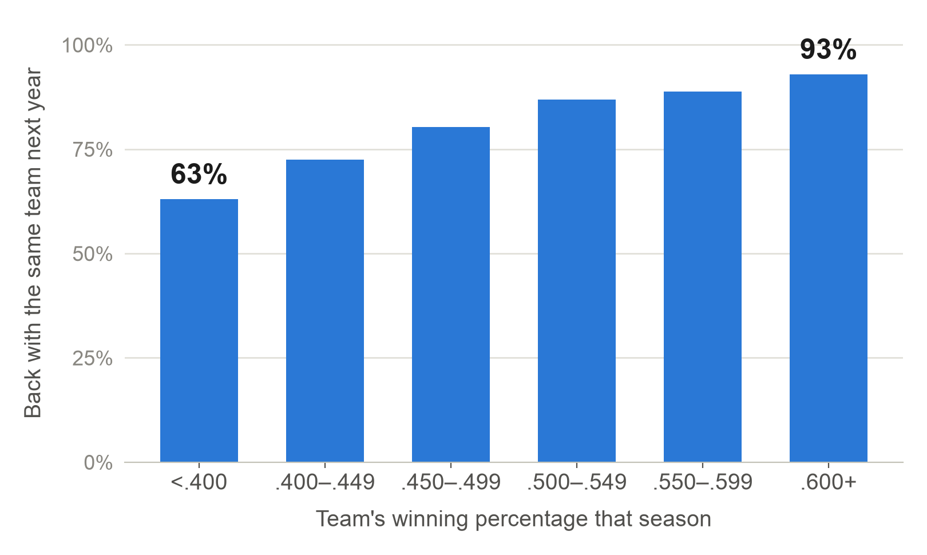
QUESTION 1 · DOES WINNING KEEP YOUR JOB?
The more you win, the safer your job
63%
of managers under .400 were back the next year
93%
of managers above .600 were back the next year
Average win %: 51.2% for managers kept vs. 46.1% for those let go
Welch's t-test: t = 11.4, p < 0.001
n = 2,395 managers who finished the season
Data: Sean Lahman Baseball Database, 1901–2017
4
Notes:
First question: does winning keep you employed? Yes, and the pattern is really steady.
Among managers whose team won less than 40% of its games, only 63% were back the next year. Every step up in winning percentage, that number climbs, all the way to 93% for managers above .600.
On average, managers who kept their jobs won 51.2% of their games, compared to 46.1% for the ones who didn't come back. We used Welch's t-test, and a gap that big is very unlikely to be random chance.

Slide 5
THIS SURPRISED US
Winning isn't always enough
20
YEAR
MANAGER
TEAM
RECORD
1953
Chuck Dressen
Brooklyn Dodgers
105–49
1964
Yogi Berra
New York Yankees
99–63
managers won 60%+ of their games and still weren't back the next season
1980
Dick Howser
New York Yankees
103–59
2002
Art Howe
Oakland Athletics
103–59
6 of them managed the Yankees.
"Not back" could mean fired, quit, retired, or promoted.
Data: Sean Lahman Baseball Database, 1901–2017
5
Notes:
But this result surprised us: winning isn't always enough. Twenty managers won at least 60% of their games and still weren't back the next season, and six of them managed the Yankees.
Chuck Dressen won 105 games with the Dodgers in 1953 and didn't come back. Yogi Berra won the pennant with the Yankees in 1964 and was let go right after the World Series.
One thing to keep in mind: our data can't tell a firing apart from someone quitting, retiring, or getting promoted. But even a great record clearly doesn't guarantee the job.

Slide 6
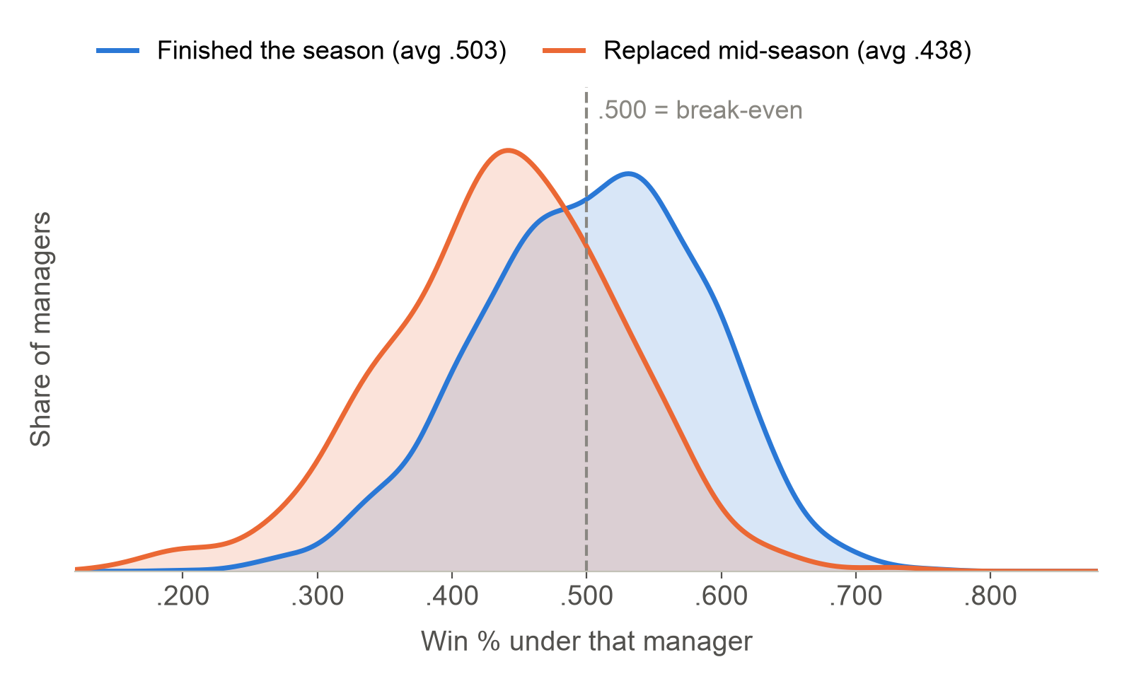
QUESTION 2 · MID-SEASON FIRINGS
Mid-season firings hit losing teams
76%
of replaced managers had a losing record (vs. 46% who finished)
.438
win % of replaced managers, vs. .503 for those who finished
~80 games
in before the change, about halfway through the season
Welch's t−test: t = −13.3, p < 0.001
n = 357 replaced vs. 2,430 finished
Data: Sean Lahman Baseball Database, 1901–2017
6
Notes:
Second question: who gets replaced in the middle of the season? Almost always, losing teams.
Managers who were replaced mid-season had won just 43.8% of their games, compared to 50.3% for managers who finished the year. On the chart, the orange curve is the replaced managers, and it's shifted clearly to the left of .500. About three out of four replaced managers had a losing record. And the typical one was gone about 80 games in, right around the halfway point of the season.

Slide 7
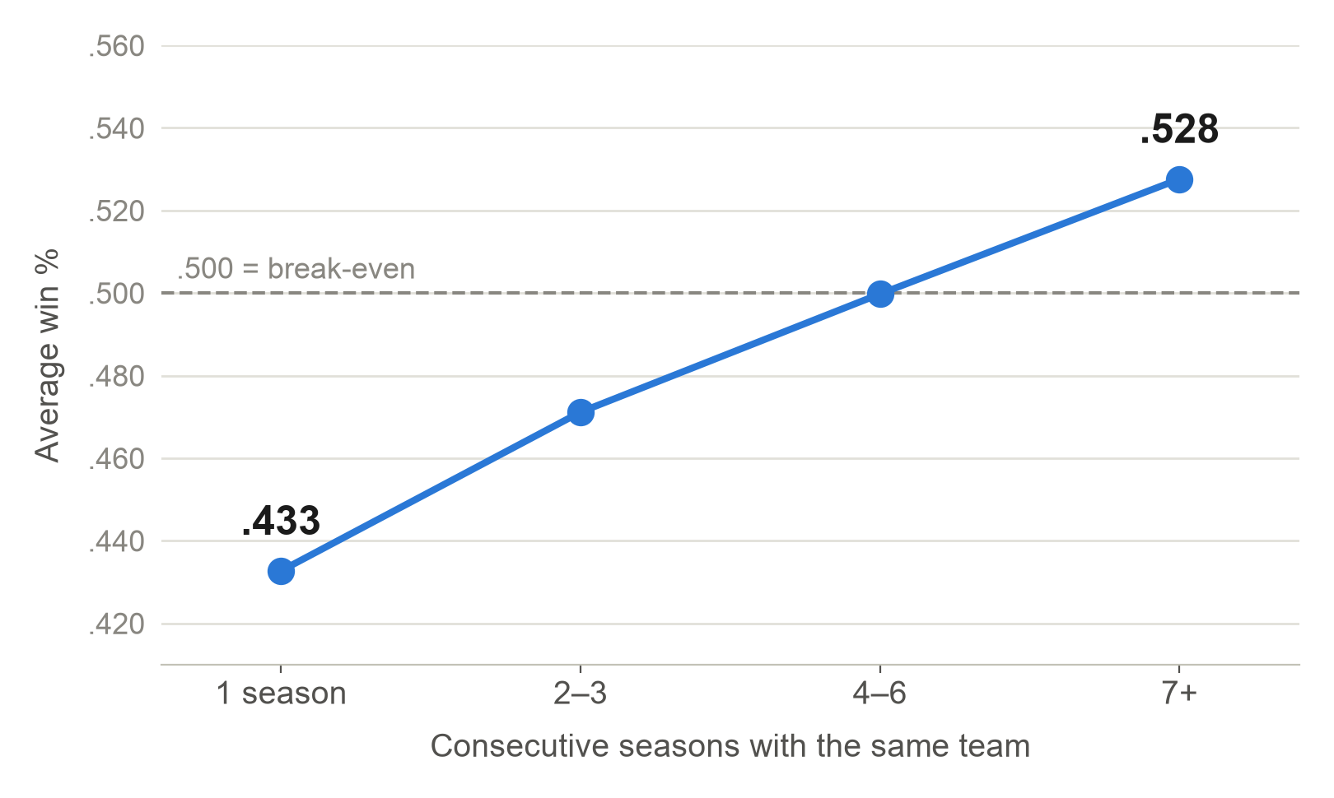
QUESTION 3 · TENURE
Managers who stay longer win more
DIDN'T MAKE SENSE AT FIRST
Connie Mack
managed the Philadelphia A's for 50 straight seasons, with a losing .484 record.
Explained by: he was also a co-owner of the team.
Spearman ρ = 0.39, p < 0.001
n = 797 runs with one team (20+ games)
Data: Sean Lahman Baseball Database, 1901–2017
7
Notes:
Third: do managers who stay longer win more? They do. Managers who only lasted one season with a team averaged a .433 winning percentage. Managers who lasted seven or more seasons averaged .528.
But this can be explained in both directions: good managers get to stay, and staying means you survived the bad years. So it's a correlation, not proof that sticking around makes you win.
And one data point didn't make sense at first. Connie Mack managed the Philadelphia A's for 50 straight seasons with a losing record. That's explained by the fact that he was also a co-owner of the team. It's hard to fire yourself.

Slide 8
TAKEAWAYS
Winning keeps managers employed, mostly
63% → 93%
Job security climbs steadily with winning percentage
3 in 4
managers replaced mid-season had a losing record
.433 → .528
Longer tenures go with better records
Keep in mind: this is correlation, not causation. "Not back" includes quitting and retiring, and winning isn't the only thing owners judge.
Thanks! Questions?
Data: Sean Lahman Baseball Database, 1901–2017
8
Notes:
So, to wrap up: job security climbs steadily with winning, three out of four mid-season firings hit managers with losing records, and longer tenures go with better records.
This matters because it gives front offices and managers a realistic picture of job security. A losing record is the biggest warning sign, but as the Yankees showed, even winning isn't a guarantee.
Thanks! We're happy to take any questions.

